Slide 1
Coursera Capstone IBM Data Science Capstone
Opening a new shopping center in Germany
By Henrik Vérolet

Slide 2
Business Question
Location of the shopping mall is one of the most important decisions that will determine whether the mall will be a success or a failure
Objective: To analyse and select the best locations in Germany to open a new shopping mall
This project is timely as the city is currently suffering from oversupply of shopping malls

Slide 3
Methodology
Web scraping Wikipedia page for cities list
Get latitude and longitude coordinates using Geocoder
Use Foursquare API to get venue data
Group data by City and taking the mean of the frequency of occurrence of each venue category
Filter venue category by Shopping Mall
Perform clustering on the data by using k-means clustering
Visualize the clusters in a map using Folium

Slide 4
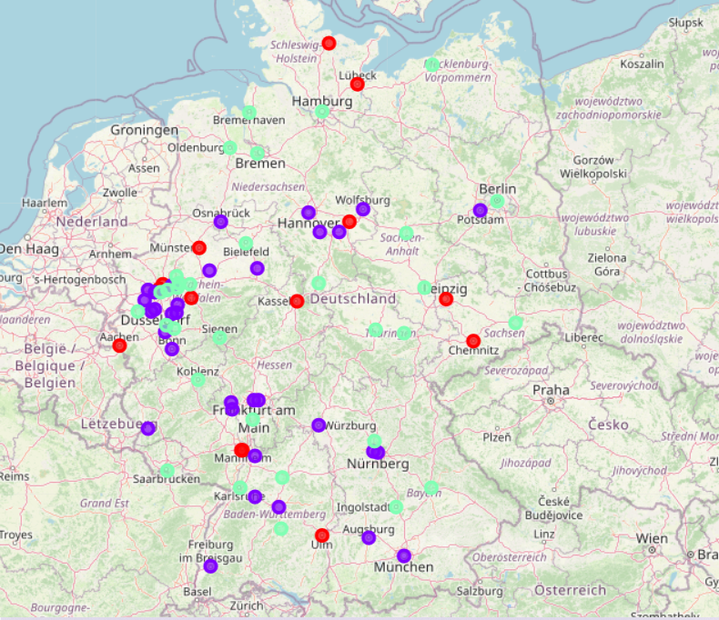
Results
Categorized the cities into 3 clusters :
➢Cluster 0: cities with moderate number of shopping malls
➢Cluster 1: cities with low number to no existence of shopping malls
➢Cluster 2: cities with high concentration of shopping malls

Slide 5
Discussion
Highest number in cluster 2 and moderate number in cluster 0
Cluster 1 has very low number to no shopping mall in the Cities

Slide 6
Recommendation
• Open new shopping malls in Cities in cluster 1 with little to no competition
• Can also open in Cities in cluster 0 with moderate competition if have
unique selling propositions to stand out from the competition
• Avoid Cities in cluster 2, already high concentration of shopping malls and intense competition

Slide 7
Thank You!

